Slide 1
19AD784
IMAGE ANALYSIS AND COMPUTER VISION
Dr E Emerson Nithiyaraj
AP/ECE

Slide 2
There are numerous ways to acquire images, but our objective in all is the same: to generate digital images from sensed data.
The output of most sensors is a continuous voltage waveform whose amplitude and spatial behavior are related to the physical phenomenon being sensed.
To create a digital image, we need to convert the continuous sensed data into digital form. This involves two processes: sampling and quantization.

Slide 3
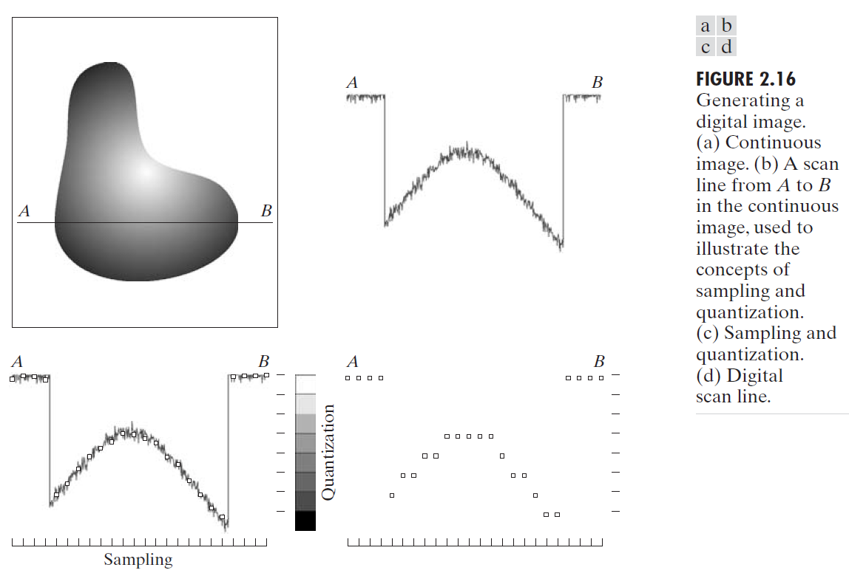
Image Sampling and Quantization

Slide 4
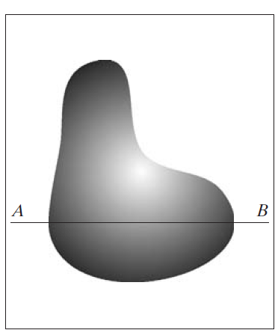
An image may be continuous with respect to the x- and y-coordinates, and also in amplitude.
To convert it to digital form, we have to sample the function in both coordinates and in amplitude.
Digitizing the coordinate values is called sampling. Digitizing the amplitude values is called quantization.

Slide 5
The one-dimensional function is a plot of amplitude (intensity level) values of the continuous image along the line segment AB.
The random variations are due to image noise.

Slide 6
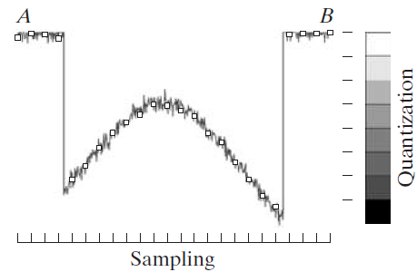
To sample this function, we take equally spaced samples along line AB.
The set of these discrete locations gives the sampled function.
However, the values of the samples still span (vertically) a continuous range of intensity values.
In order to form a digital function, the intensity values also must be converted (quantized) into discrete quantities.

Slide 7
The intensity scale divided into eight discrete intervals, ranging from black to white.
The vertical tick marks indicate the specific value assigned to each of the eight intensity intervals.
The continuous intensity levels are quantized by assigning one of the eight values to each sample.

Slide 8
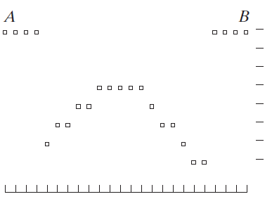
The digital samples resulting from both sampling and quantization are shown.
Starting at the top of the image and carrying out this procedure line by line produces a two-dimensional digital image.
It is implied that, in addition to the number of discrete levels used, the accuracy achieved in quantization is highly dependent on the noise content of the sampled signal.

Slide 9
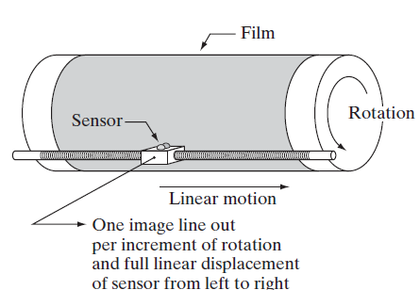
The method of sampling is determined by the sensor arrangement used to generate the image.
When an image is generated by a single sensing element combined with mechanical motion, the output of the sensor is quantized in the manner described above.

Slide 10
However, spatial sampling is accomplished by selecting the number of individual mechanical increments at which we activate the sensor to collect data.
Mechanical motion can be made very exact so, in principle, there is almost no limit as to how fine
we can sample an image using
this approach.

Slide 11
When a sensing strip is used for image acquisition, the number of sensors in the strip establishes the sampling limitations in one image direction.
Mechanical motion in the other direction can be controlled more accurately, but it makes little sense to try to achieve sampling density (detail) in one direction that exceeds the sampling limits established by the number of sensors in the other.
Quantization of the sensor outputs completes the process of generating a digital image.

Slide 12
When a sensing array is used for image acquisition, there is no motion and the number of sensors in the array establishes the limits of sampling in both directions.
Clearly, the quality of a digital image is determined to a large degree by the number of samples and discrete intensity levels used in sampling and quantization.

Slide 13
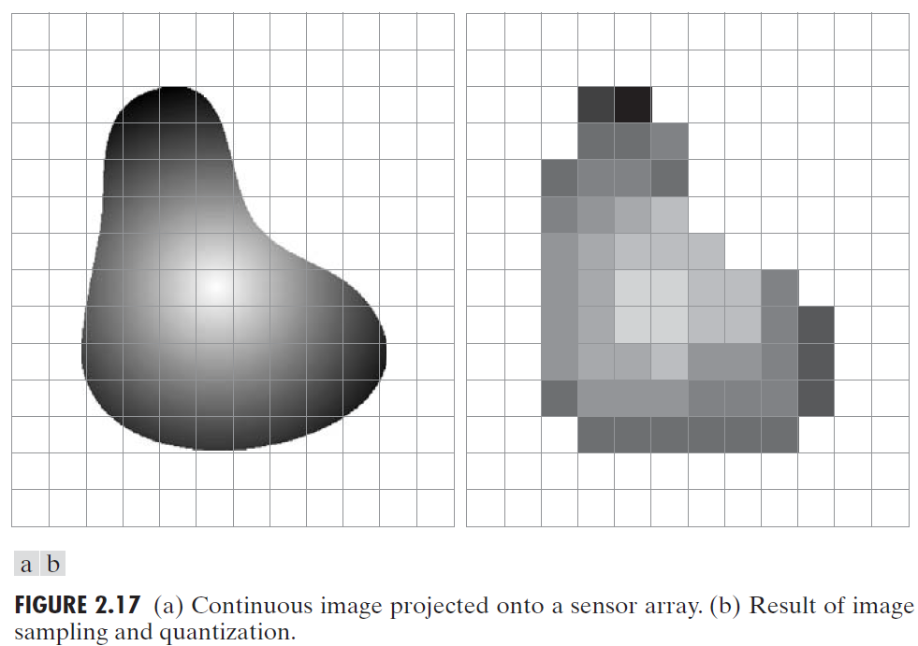

Slide 14
Representation of Digital Images
Let f(s,t)represent a continuous image
We sample the continuous image into a 2-D array, f(x, y), containing M rows and N columns, where (x, y) are discrete coordinates.
x = 0, 1, 2, M – 1; y = 0, 1, 2, N - 1.
f(0, 1) - the second sample along the first row.

Slide 15
Representation of Digital Images
The section of the real plane spanned by the coordinates of an image is called the spatial domain, with x and y being referred to as spatial variables or spatial coordinates.
The entire area where the image is spread out is the spatial domain, and the x and y coordinates help us pinpoint specific locations within that area.

Slide 16
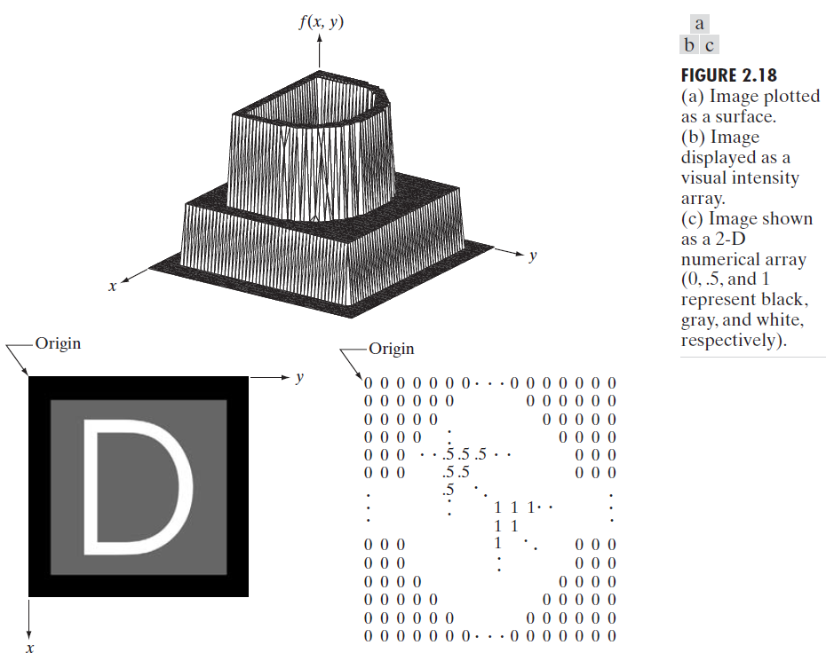
Three basic ways to represent f(x, y)

Slide 17
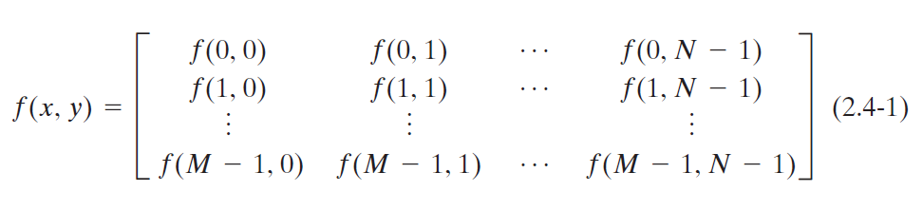
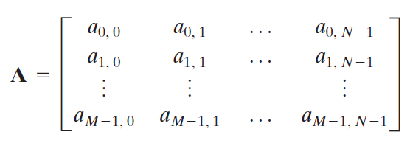

image element, picture element, pixel, or pel.

Slide 18
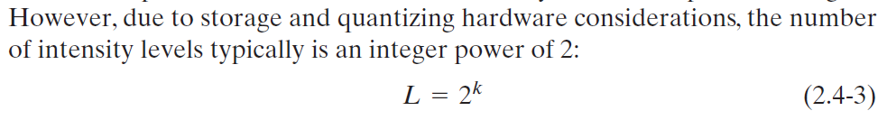
The range of values spanned by the gray scale is referred to informally as the dynamic range. The dynamic range of an imaging system to be the ratio of the maximum measurable intensity to the minimum detectable intensity level in the system. This is a measure of how much detail an imaging system can capture in terms of brightness.
The upper limit is determined by saturation and the lower limit by noise
Dynamic range establishes the lowest and highest intensity levels that a system can represent and, consequently, that an image can have.

Slide 19
Contrast, which we define as the difference in intensity between the highest and lowest intensity levels in an image.
When an appreciable number of pixels in an image have a high dynamic range, we can expect the image to have high contrast.
Conversely, an image with low dynamic range typically has a dull, washed-out gray look.

Slide 20
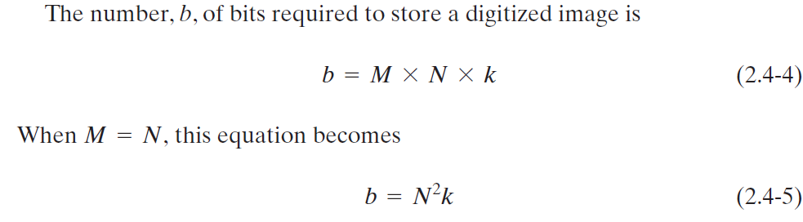
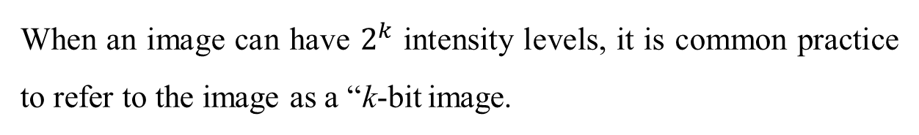
When an image can have $2^{k}$ intensity levels, it is common practice to refer to the image as a “k-bit image.

Slide 21
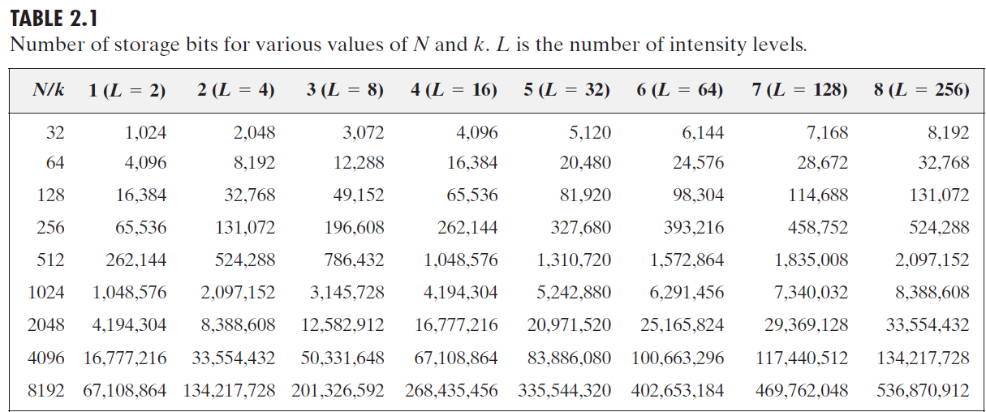

Slide 22
Spatial Resolution
Spatial resolution is a measure of the smallest discernible detail (tiniest part of the image that can be clearly seen) in an image.
Spatial resolution is about how sharp and detailed the image is. Higher spatial resolution means you can see finer details in the image.
line pairs per unit distance, and dots (pixels) per unit distance
The "smallest discernible detail" refers to the tiniest feature or element in an image that can be clearly seen and distinguished from other features.

Slide 23
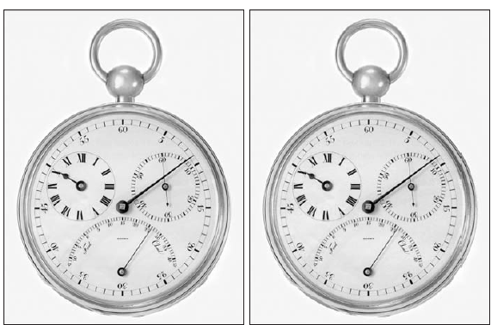
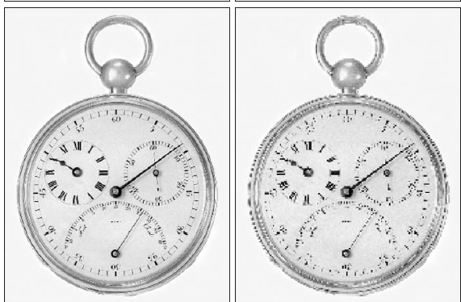
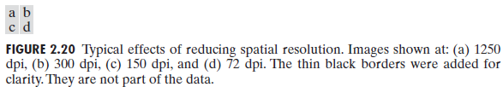

Slide 24
Image Resolution
Image resolution is the largest number of discernible line pairs (pairs of lines (one dark, one light) that you can see clearly as separate lines) per unit distance (e.g., 100 line pairs per mm).
Dots per unit distance is a measure of image resolution used commonly in the printing and publishing industry. (dpi – dots per inch)
Image resolution is the highest number of pairs of lines you can see clearly in a given length. Higher image resolution means more detail, as you can see more line pairs in the same amount of space.

Slide 25
Intensity Resolution
Intensity resolution similarly refers to the smallest discernible change in intensity level.
The smallest discernible change in intensity level means the smallest difference in how light or dark something appears that you can detect with your eyes or an imaging system.
For example, it is common to say that an image whose intensity is quantized into 256 levels has 8 bits of intensity resolution.

Slide 26
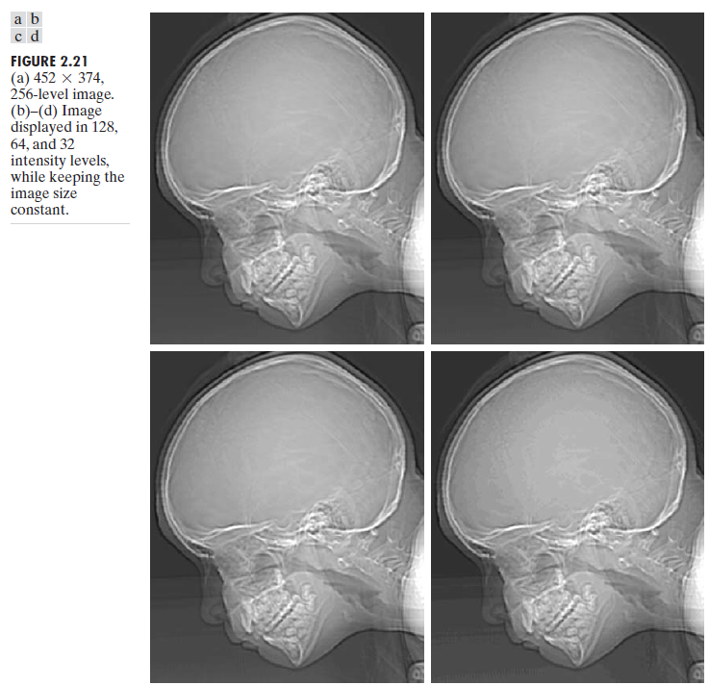
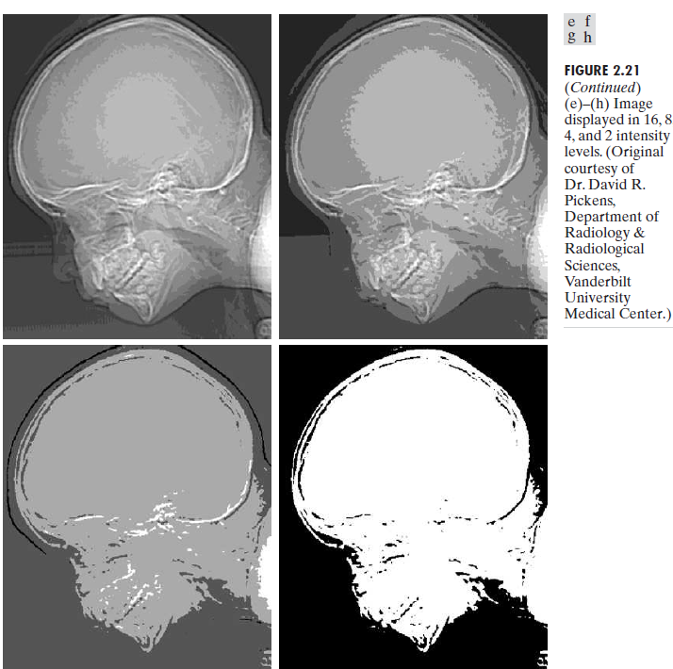
False contouring generally is quite visible in images displayed using 16 or less uniformly spaced intensity levels. caused by the use of an insufficient number of intensity levels in smooth areas of a digital image

Slide 27
Image Interpolation
Interpolation is a basic tool used extensively in tasks such as zooming, shrinking, rotating, and geometric corrections.
Interpolation is the process of using known data to estimate values at unknown locations.
Nearest neighbor interpolation because it assigns to each new location the intensity of its nearest neighbor in the original image.
This approach is simple but,, it has the tendency to produce undesirable artifacts, such as severe distortion of straight edges.

Slide 28

Image Interpolation
Bilinear interpolation, in which we use the four nearest neighbors to estimate the intensity at a given location.
Bilinear interpolation gives much better results than nearest neighbor interpolation, with a modest increase in computational burden.

Slide 29
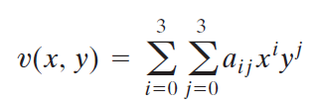
Image Interpolation
Bicubic interpolation, which involves the sixteen nearest neighbors of a point.
Bicubic interpolation does a better job of preserving fine detail than its bilinear counterpart.
Bicubic interpolation is the standard used in commercial image editing programs, such as Adobe Photoshop and Corel Photopaint.

